Slide 1
What is Git?
• Modern version control system (VCS)
• Actively maintained open-source project
• Developed by Linus Torvalds in 2005
• Uses a distributed architecture
• Designed for performance, security and flexibility

Slide 2
Git vs Other VCSs
• Git stores and thinks about information in a very different way
• Most other VCS systems store information as a list of file-based changes:
This is delta-based version control
• Git doesn't store data this way:
Git takes a snapshots of the current state

Slide 3
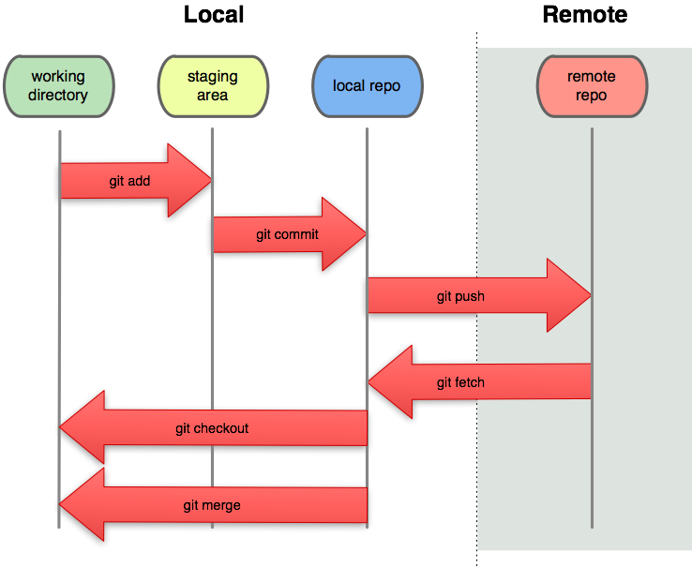

Slide 4
How Git Works
• Almost all operations are local
• Uses checksums to maintain data integrity
• Nearly all of Git actions only add data
• Git file states:
• Committed
• Modified
• Staged

Slide 5
How Git Works (cont.)
• The Git directory is where metadata and an object database are stored:
• This is what is cloned locally
• The working tree pulled from the Git directory
• The staging area is a file in the Git directory
• The basic Git workflow:
• Files are modified
• Changes are selectively staged
• Commit the changes that are staged

